Slide 1
Data analysis on movie lens
GROUP -6
S.K.H.Praneeth Nooli
Rahul Ghadge

Slide 2
motivation
True Story – Movie Recommendation.
Meaning of recommending movies
What you think--- You should watch a movie which I liked.
What listener thinks-- Have you seen any movies I would like to see?
Recommending movie seems both incredibly difficult and complicated to answer, yet surprisingly relevant both socially for individuals, and economically for direct-to-consumer movie services.

Slide 3
motivation
For Movie streaming businesses like Netflix®
Each time a new member logs-in for the first time, Netflix® must recommend a movie to that new user.
But how? What do they know about a user-
Sign up information like age, gender, occupation etc.

Slide 4
Data - MovieLens 1M Ratings
6k
3.8k
1m
users
movies
reviews
gender
age
occupation
zip code
title
genre
movie
user
rating
timestamp

Slide 5
Objectives
Summary Statistics: Ratings
Histograms:Distribution of Ratings
Scatter Plots: Correlation between Men and Women
Business Intelligence: Business Questions

Slide 6
Summary statistics
Ratings> 4.5 | Count
All Users | 21
Men | 23
Women | 51
Ratings>4.5 and Age>30 | Count
Men | 86
Women | 149

Slide 7
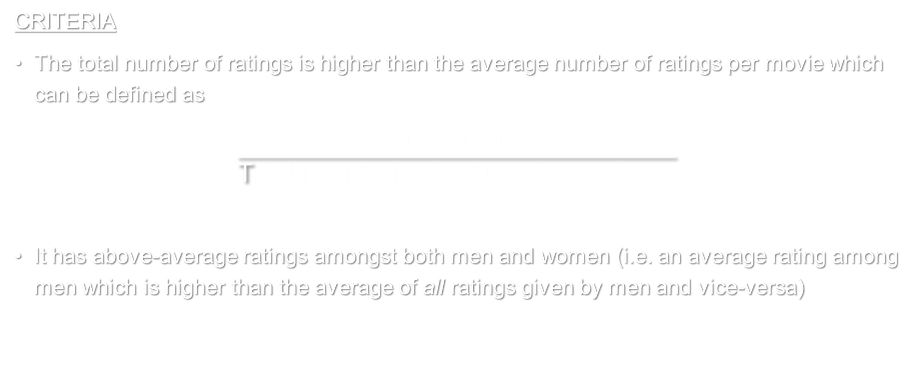
TOP 10 MOST POPULAR MOVIES
Summary statistics
CRITERIA
The total number of ratings is higher than the average number of ratings per movie which can be defined as
$$\frac{\text{Sum} \text{of} \text{ratings}}{\text{T}\text{otal} \text{no}\text{. }\text{movies} \text{that} \text{received} \text{ratings} }$$
It has above-average ratings amongst both men and women (i.e. an average rating among men which is higher than the average of all ratings given by men and vice-versa)

Slide 8
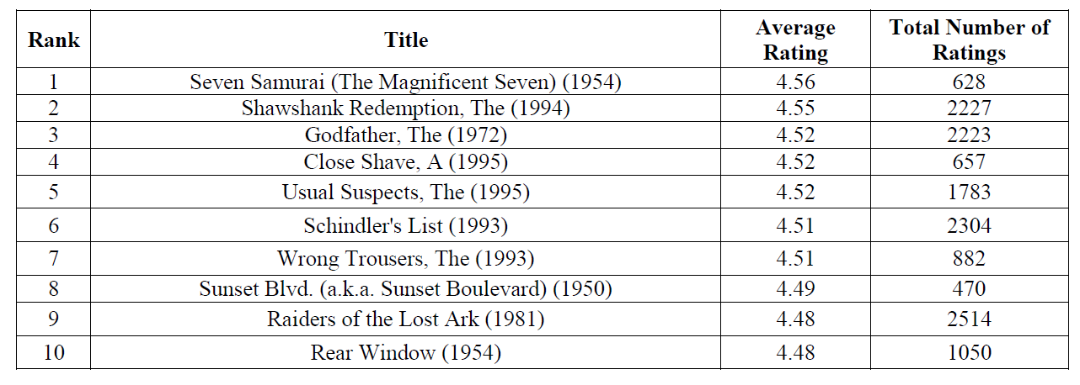
Summary statistics

Slide 9
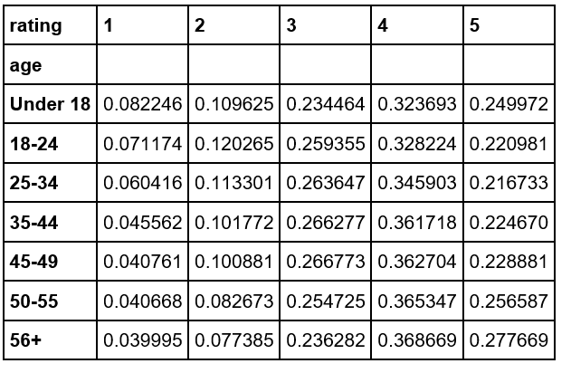
Summary statistics
Conjecture: The older a person gets, the more difficult they are to please.
Approach :
We consider the percent of each type of rating (1-5) given by each age group

Slide 10
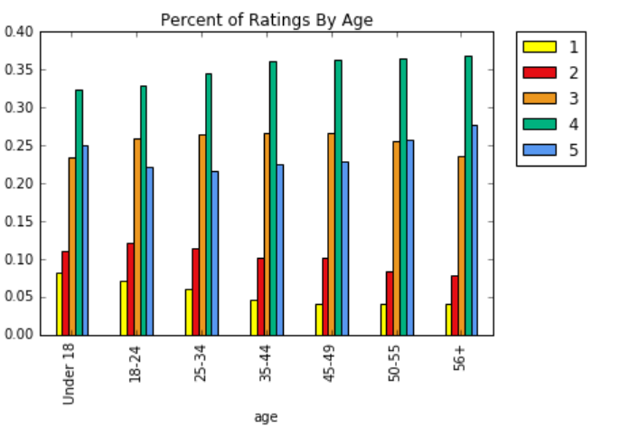
Summary statistics

Slide 11
Conclusion-False
Summary statistics
In fact, result from the data supports the opposite conjecture:
Older people are:
more likely than younger people to give a rating of 5
less likely to give a rating of 1
Therefore our data supports that people become easier to please as they get older!

Slide 12
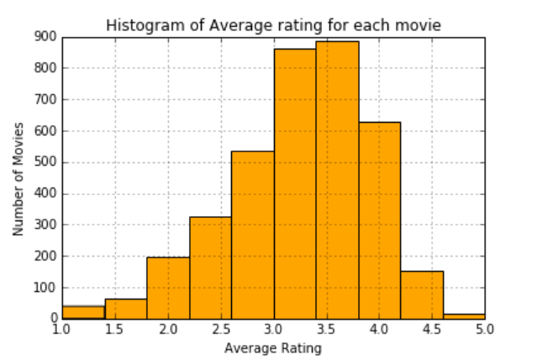
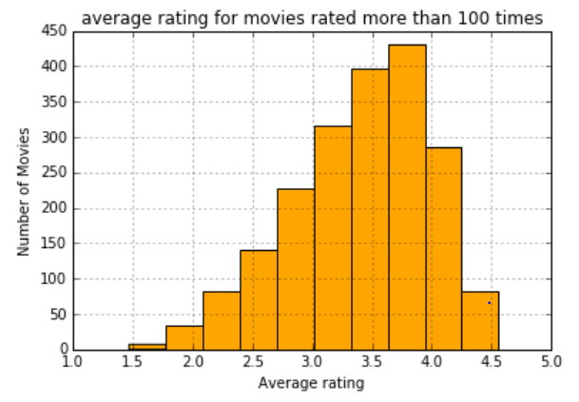
Average rating for each movie vs Average rating for movies which are rated more than 100 times.
Histograms:Distribution of Ratings
1. The majority of users tend to rate movies between 3 and 4 stars in both the cases.
2. The tails disappear when we only use movies rated more than 100 times.
3. Kurtosis analysis:
The original histogram has a kurtosis of 0.3246, the kurtosis becomes -0.2478 in the second histogram.
Tails change from “fat” to “thin”

Slide 13
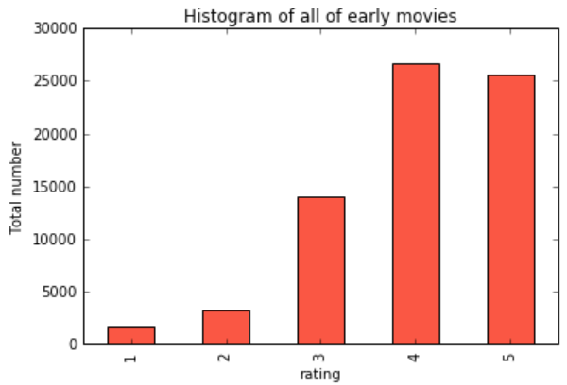
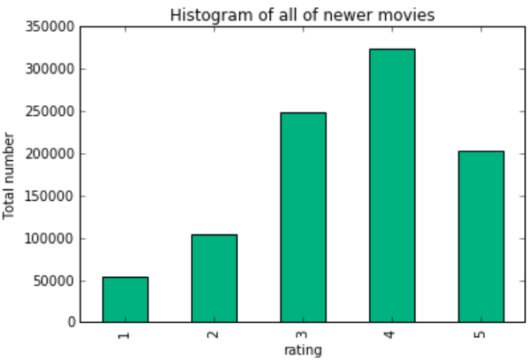
Conjecture: Do People like to watch older movies than newer movies
Approach :
Based on the average release year among the movies they are classified in to older & new movies and then calculated the total number of ratings of each type(1-5) for these two set of movies

Slide 14
Conclusion-False
Newer movies have been rated much more frequently and its distribution is much closer to a normal distribution .
Among older movies, the distribution is unbalanced which indicates that
People watch older movies in order to reminisce and
People watch newer movies in order to be enternained

Slide 15
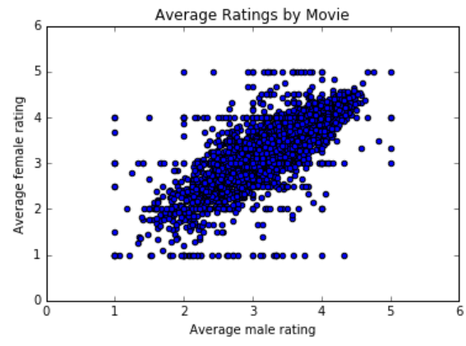
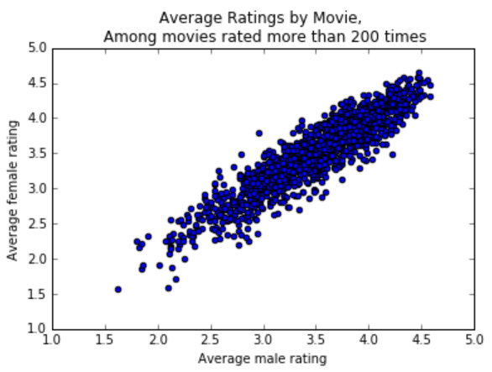
Scatter Plots: Correlation between Men and Women
Correlation Coefficient: 0.763
(moderate )
Correlation Coefficient: 0.918
(High)
Conclusion- Men and women tend to agree more when the movies have a higher total number of ratings

Slide 16
Conjecture: When they are tired Male and female rate more similarly
Approach :
Isolate data for ratings submitted between 10PM and 5AM local time.
Determine the average ratings per title by gender during these late-night hours.
Compute the correlation coefficient.

Slide 17
Conclusion-True
Correlation coefficient (for all the movies): 0.644
Correlation coefficient (with at least 200 total ratings): 0.865
Based on this data, we conclude that males and females rate movies similarly and it is especially strong when considering movies with at least 200 ratings.

Slide 18
Business Intelligence: Business Questions
What genre of Movie should Netflix recommend to a first-time user based on their log-in information?
Method: We focus our analysis on the two most “active” genres Comedy and Adventure and propose two specific Questions.

Slide 19
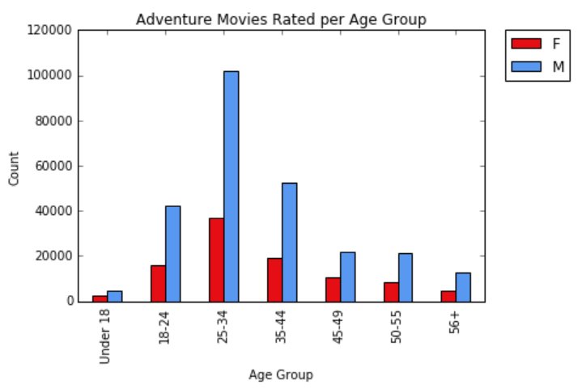
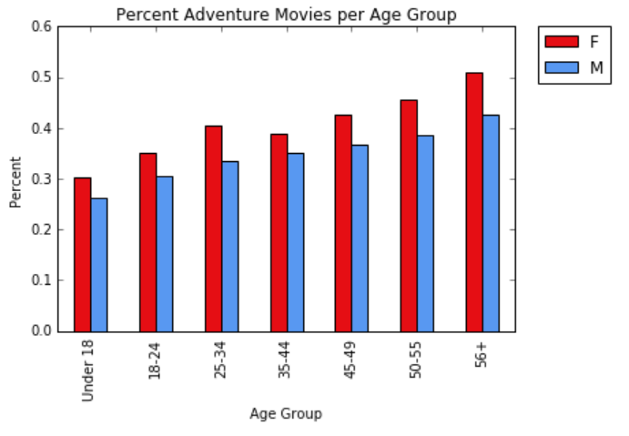
A. What age group watches the most adventure movies?
Total Adventure movies rated per Age group
Percent of all movies rated that are Adventure

Slide 20
Conclusion
Women show a particularly strong interest in Adventure movies
Nearly half of movies watched by older women were adventure movies
Older people are more interested in adventure movies than younger individuals

Slide 21
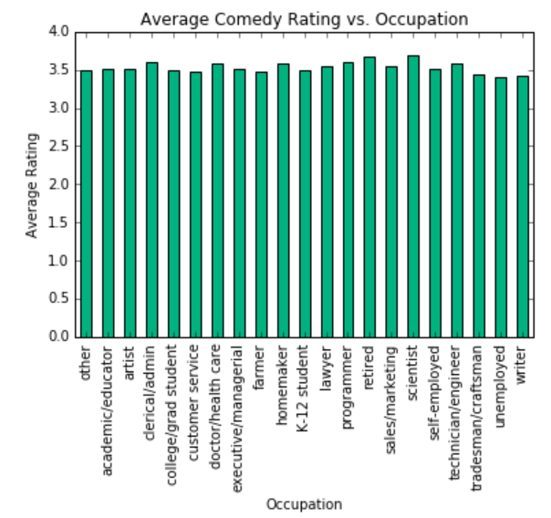
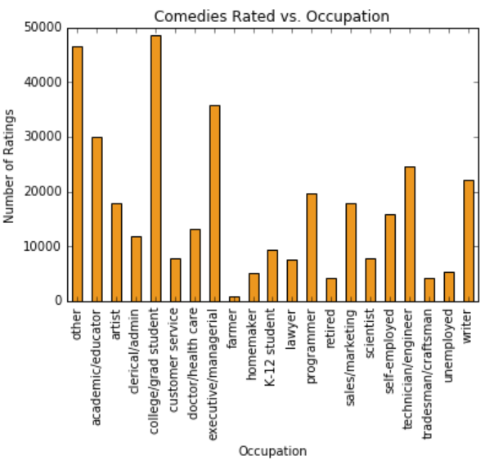
B. Which occupation is most likely to enjoy a comedy?

Slide 22
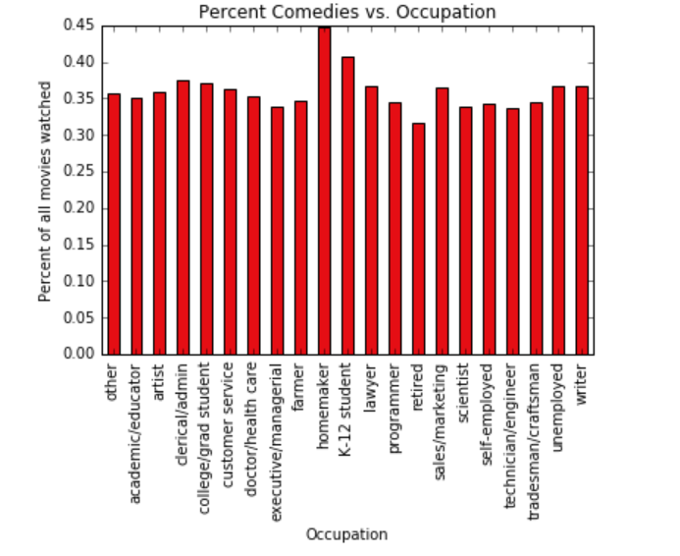

Slide 23
Conclusion
College students, homemakers, and children all show high interest in comedies compared to other occupations

Slide 24
Questions???

